Slide 1
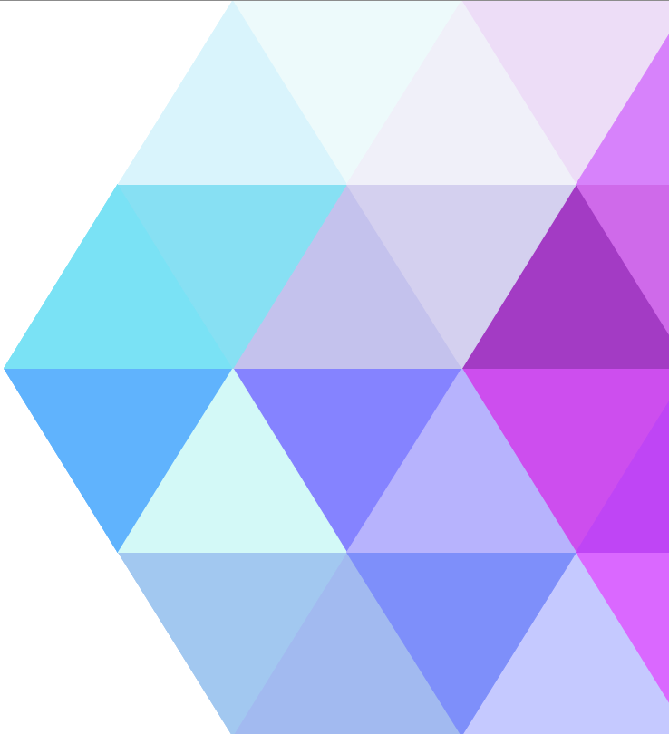

Internet Security & Privacy
Jucker Marco & Winkler Olivier

Slide 2
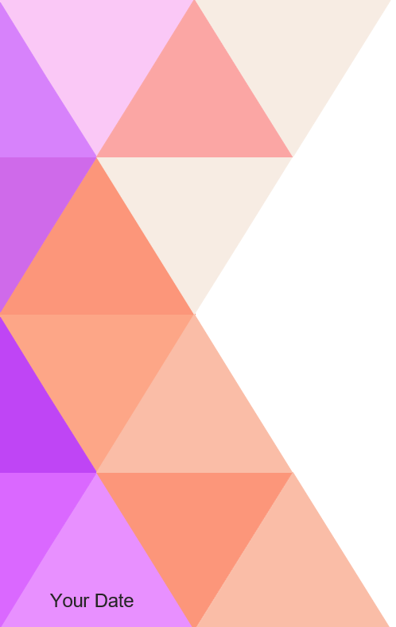
Brainstorming
Internet Security
Cloud
Virtual Private Network (VPN)
Malware
Virus
Ransomware
OWASP Top 10
SQL Injection
Broken Authentication
Sensitive Data Exposure
XML External Entities
Broken Access Control
Security Misconfiguration
Cross-Site Scripting XSS
Insecure Deserialization
Using Components with Known Vulnerabilities
Insufficient Logging & Monitoring
Backdoor
Brute force attack
Captcha
Cookie
Phising
DDos
Spyware
SSL
Two-factor authentication

Slide 3
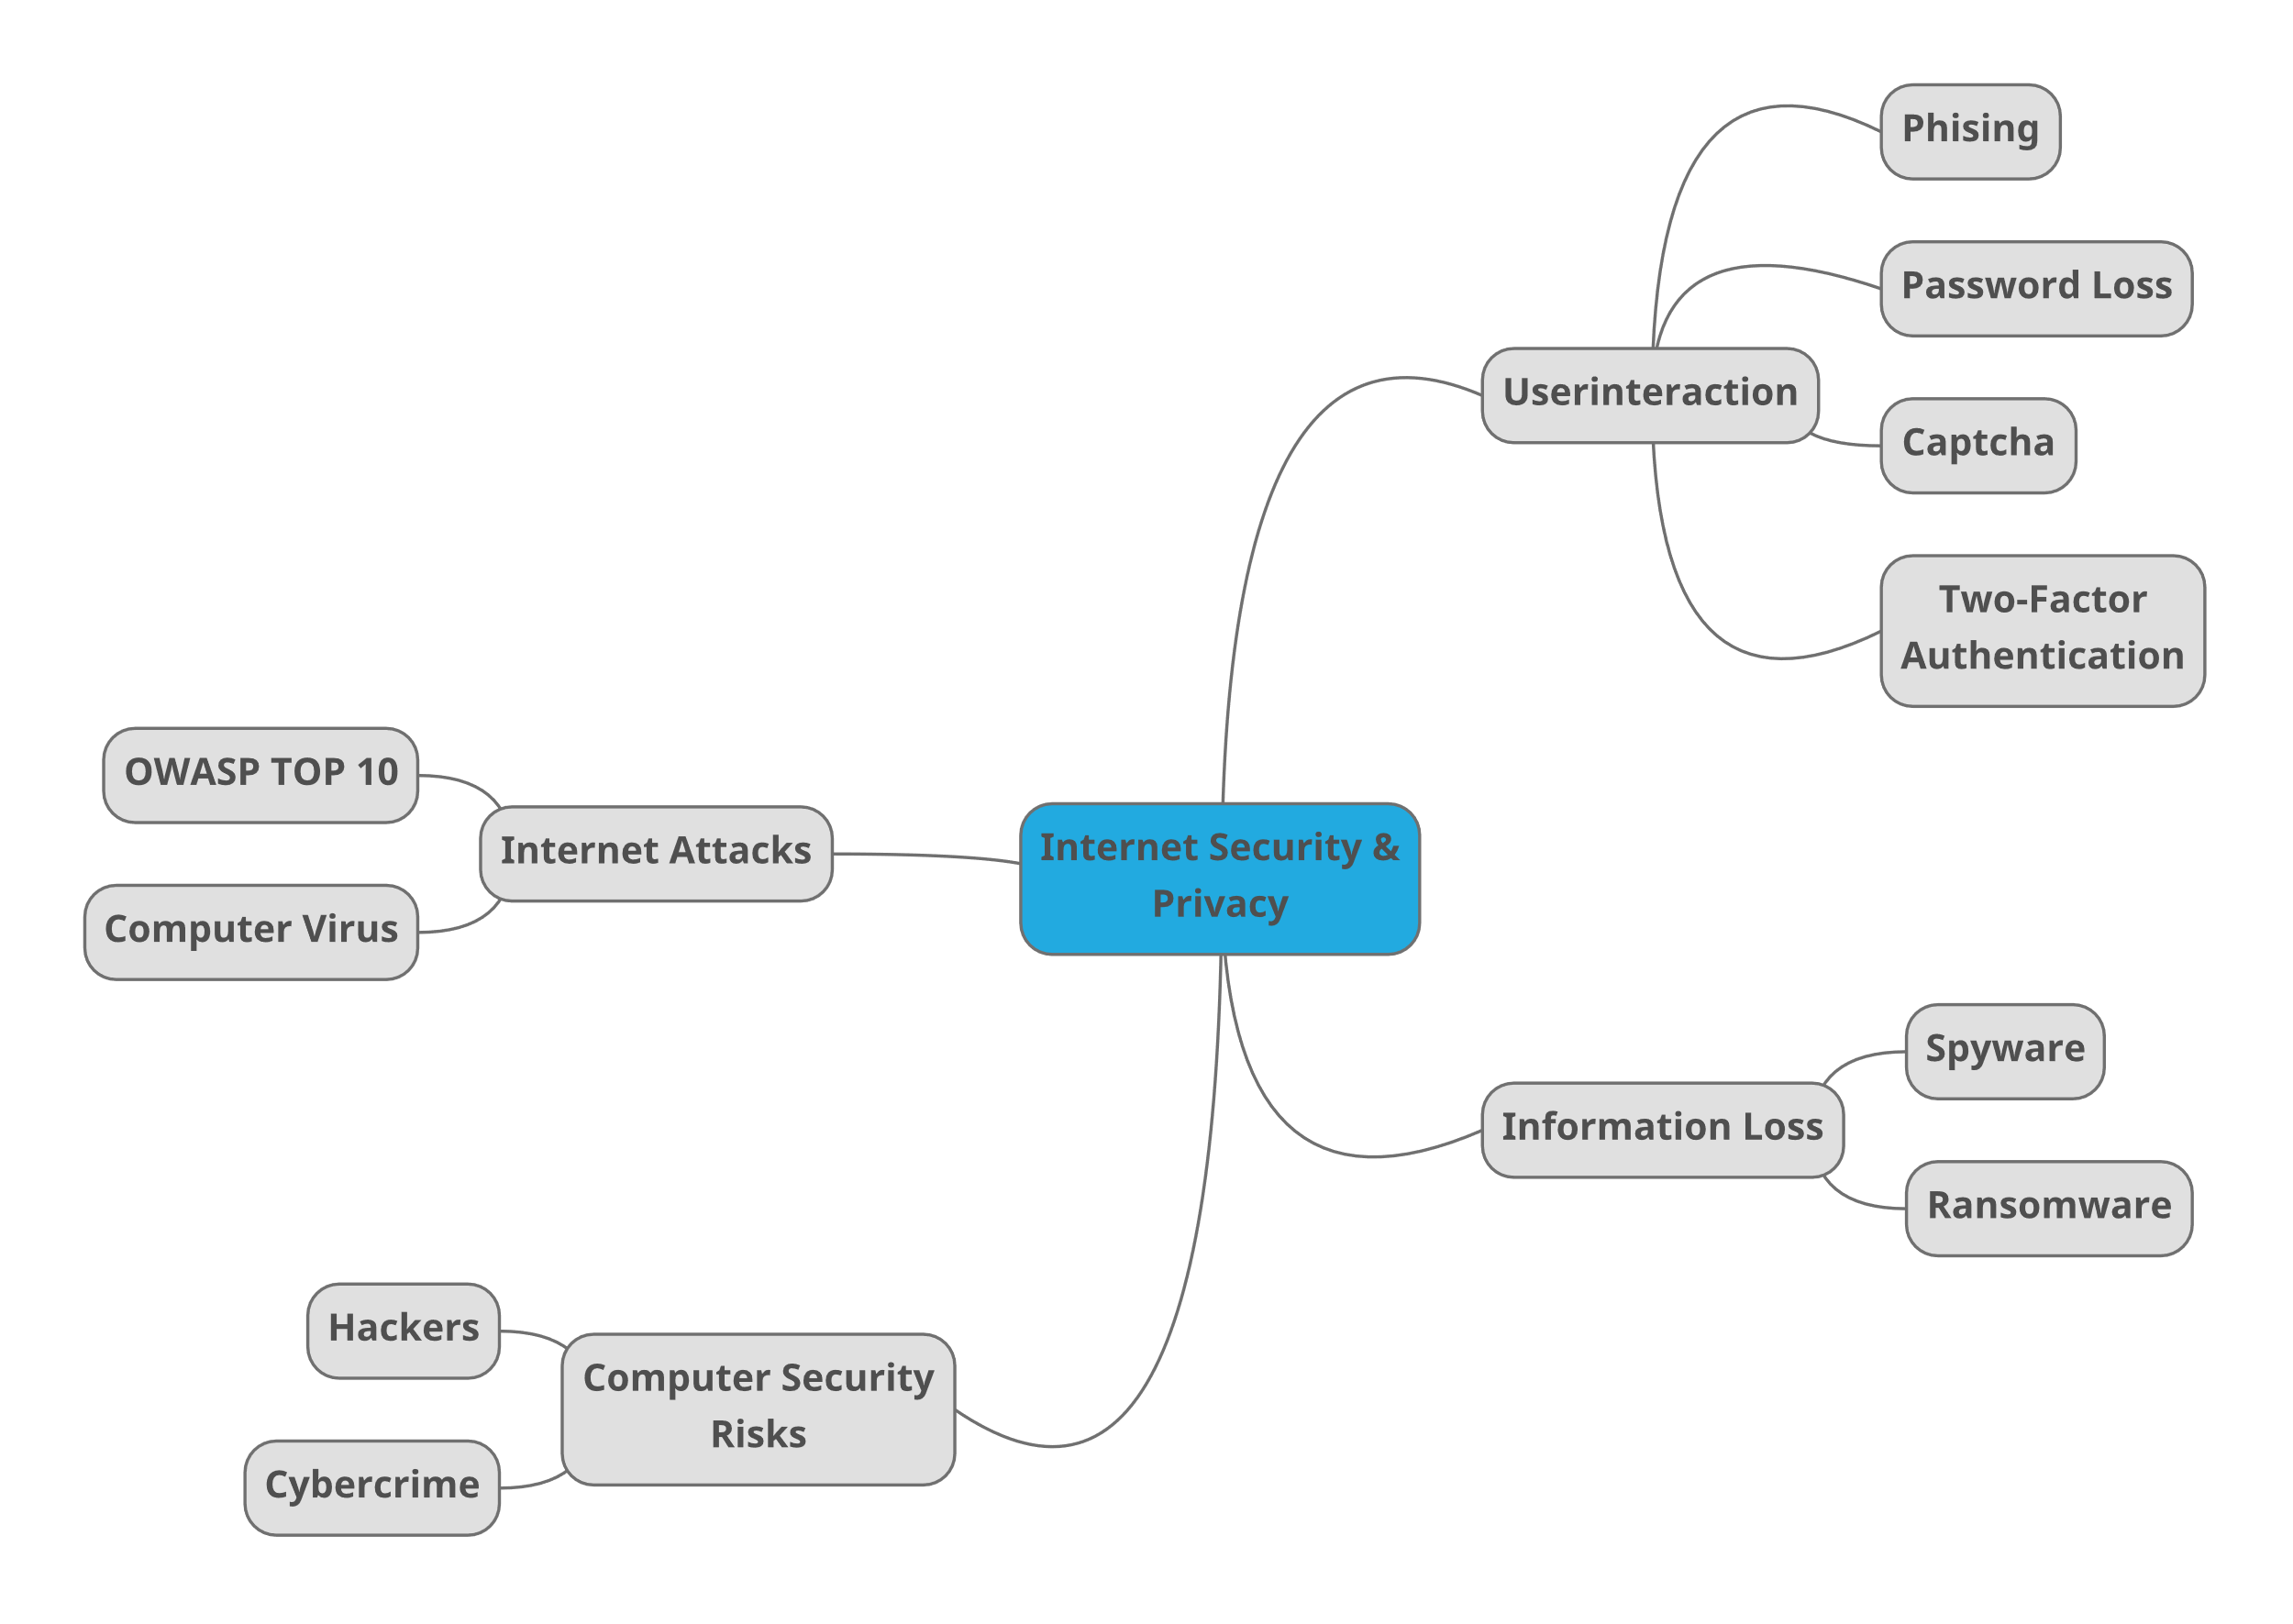




Slide 9
Sensitive Data Exposure
XML External Entities
SQL Injection
Insecure Deserialization
Broken Authentication
Insufficient Logging & Monitoring
Cross-Site Scripting XSS
Broken Access Control
Security Misconfiguration
Using Components with Known Vulnerabilities

